Slide 1

Slides developed by Mine Çetinkaya-Rundel of OpenIntro
Translated from LaTeX to Google Slides by Curry W. Hilton of OpenIntro.
The slides may be copied, edited, and/or shared via the CC BY-SA license
To make a copy of these slides, go to File > Download as > [option], as shown below. Or if you are logged into a Google account, you can choose Make a copy... to create your own version in Google Drive.

Slide 2
Comparing means with ANOVA
Slides developed by Mine Çetinkaya-Rundel of OpenIntro
Translated from LaTeX to Google Slides by Curry W. Hilton of OpenIntro.
The slides may be copied, edited, and/or shared via the CC BY-SA license
Some images may be included under fair use guidelines (educational purposes)

Slide 3
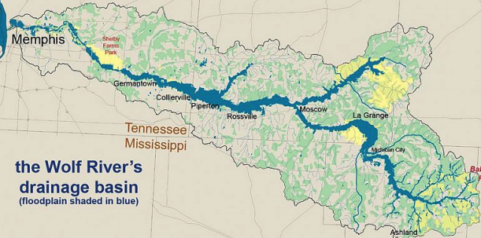
The Wolf River in Tennessee flows past an abandoned site once used by the pesticide industry for dumping wastes, including chlordane (pesticide), aldrin, and dieldrin (both insecticides)

Slide 4
The Wolf River in Tennessee flows past an abandoned site once used by the pesticide industry for dumping wastes, including chlordane (pesticide), aldrin, and dieldrin (both insecticides)
These highly toxic organic compounds can cause various cancers and birth defects

Slide 5
The Wolf River in Tennessee flows past an abandoned site once used by the pesticide industry for dumping wastes, including chlordane (pesticide), aldrin, and dieldrin (both insecticides)
These highly toxic organic compounds can cause various cancers and birth defects
The standard methods to test whether these substances are present in a river is to take samples at six-tenths depth

Slide 6
The Wolf River in Tennessee flows past an abandoned site once used by the pesticide industry for dumping wastes, including chlordane (pesticide), aldrin, and dieldrin (both insecticides)
These highly toxic organic compounds can cause various cancers and birth defects
The standard methods to test whether these substances are present in a river is to take samples at six-tenths depth
But since these compounds are denser than water and their molecules tend to stick to particles of sediment, they are more likely to be found in higher concentrations near the bottom

Slide 7
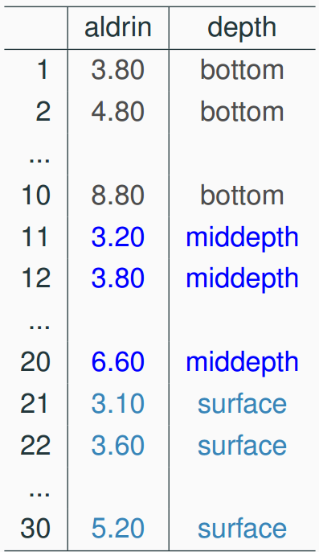
Data
Aldrin concentration (nanograms per liter) at three levels of depth

Slide 8
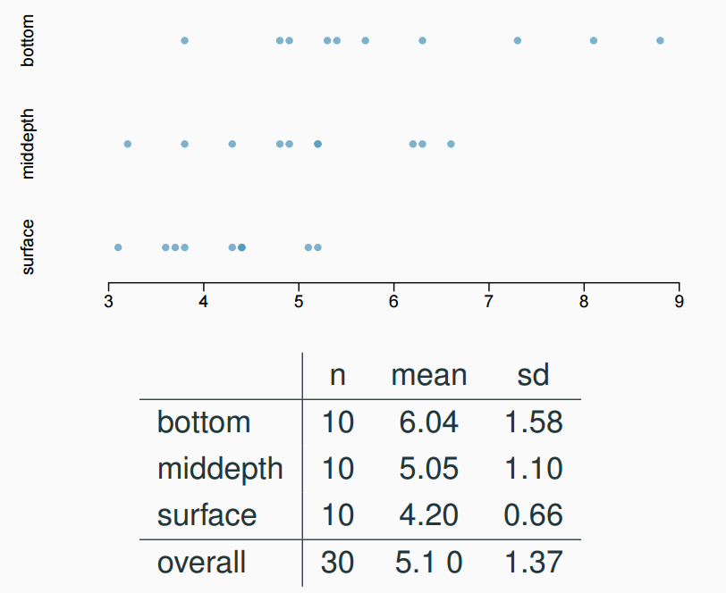
Exploratory analysis
Aldrin concentration (nanograms per liter) at three levels of depth

Slide 9
Research question
Is there a difference between the mean aldrin concentrations among the three levels?

Slide 10
Research question
Is there a difference between the mean aldrin concentrations among the three levels?
To compare means of 2 groups we use a Z or a T statistic

Slide 11
Research question
Is there a difference between the mean aldrin concentrations among the three levels?
To compare means of 2 groups we use a Z or a T statistic
To compare means of 3+ groups we use a new test called ANOVA and a new statistic called F

Slide 12
ANOVA
ANOVA is used to assess whether the mean of the outcome variable is different for different levels of a categorical variable

Slide 13
ANOVA
ANOVA is used to assess whether the mean of the outcome variable is different for different levels of a categorical variable
H₀ : The mean outcome is the same across all categories,
𝜇₁ = 𝜇₂ = … = 𝜇_{k},
where 𝜇_{i} represents the mean of the outcome for observations in category i
H_{A} : At least one mean is different than others

Slide 14
Conditions
The observations should be independent within and between groups
If the data are a simple random sample from less than 10% of the population, this condition is satisfied
Carefully consider whether the data may be independent (e.g. no pairing)
Always important, but sometimes difficult to check

Slide 15
Conditions
The observations should be independent within and between groups
If the data are a simple random sample from less than 10% of the population, this condition is satisfied
Carefully consider whether the data may be independent (e.g. no pairing)
Always important, but sometimes difficult to check
The observations within each group should be nearly normal
Especially important when the sample sizes are small
How do we check for normality?

Slide 16
Conditions
The observations should be independent within and between groups
If the data are a simple random sample from less than 10% of the population, this condition is satisfied
Carefully consider whether the data may be independent (e.g. no pairing)
Always important, but sometimes difficult to check
The observations within each group should be nearly normal
Especially important when the sample sizes are small
How do we check for normality?
The variability across the groups should be about equal
Especially important when the sample sizes differ between groups
How can we check this condition?

Slide 17
z/𝘵 test vs. ANOVA - Purpose
z/𝘵 test
Compare means from two groups to see whether they are so far apart that the observed difference cannot reasonably be attributed to sampling variability
H₀ : 𝜇₁ = 𝜇₂
ANOVA
Compare the means from two or more groups to see whether they are so far apart that the observed differences cannot all reasonably be attributed to sampling variability
H₀ : 𝜇₁ = 𝜇₂ = … = 𝜇_{k}

Slide 18


z/𝘵 test vs. ANOVA - Method
z/𝘵 test
Compute a test statistic (a ratio)
ANOVA
Compute a test statistic (a ratio)

Slide 19
z/𝘵 test vs. ANOVA - Method
z/𝘵 test
Compute a test statistic (a ratio)
ANOVA
Compute a test statistic (a ratio)
Large test statistics lead to small p-values
If the p-value is small enough H₀ is rejected, we conclude that the population means are not equal

Slide 20
z/𝘵 test vs. ANOVA
With only two groups t-test and ANOVA are equivalent, but only if we use a pooled standard variance in the denominator of the test statistic

Slide 21
z/𝘵 test vs. ANOVA
With only two groups t-test and ANOVA are equivalent, but only if we use a pooled standard variance in the denominator of the test statistic
With more than two groups, ANOVA compares the sample means to an overall grand mean

Slide 22
Hypotheses
H₀ : 𝜇_{B} = 𝜇_{M} = 𝜇_{S}
H_{A} : 𝜇_{B} ≠ 𝜇_{M} ≠ 𝜇_{S}
H₀ : 𝜇_{B} ≠ 𝜇_{M} ≠ 𝜇_{S}
H_{A} : 𝜇_{B} = 𝜇_{M} = 𝜇_{S}
H₀ : 𝜇_{B} = 𝜇_{M} = 𝜇_{S}
H_{A} : At least one mean is different
H₀ : 𝜇_{B} = 𝜇_{M} = 𝜇_{S} = 0
H_{A} : At least one mean is different
H₀ : 𝜇_{B} = 𝜇_{M} = 𝜇_{S}
H_{A} : 𝜇_{B} > 𝜇_{M} > 𝜇_{S}

Slide 23
Hypotheses
H₀ : 𝜇_{B} = 𝜇_{M} = 𝜇_{S}
H_{A} : 𝜇_{B} ≠ 𝜇_{M} ≠ 𝜇_{S}
H₀ : 𝜇_{B} ≠ 𝜇_{M} ≠ 𝜇_{S}
H_{A} : 𝜇_{B} = 𝜇_{M} = 𝜇_{S}
H₀ : 𝜇_{B} = 𝜇_{M} = 𝜇_{S}
H_{A} : At least one mean is different
H₀ : 𝜇_{B} = 𝜇_{M} = 𝜇_{S} = 0
H_{A} : At least one mean is different
H₀ : 𝜇_{B} = 𝜇_{M} = 𝜇_{S}
H_{A} : 𝜇_{B} > 𝜇_{M} > 𝜇_{S}

Slide 24
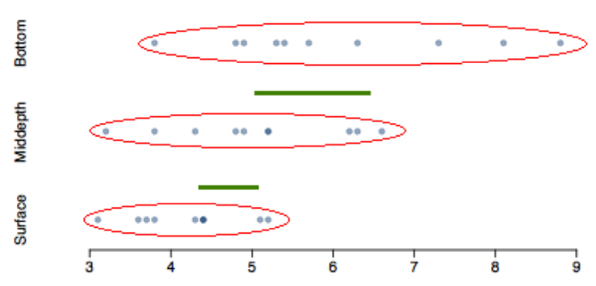
Test statistic
Does there appear to be a lot of variability within groups? How about between groups?

Slide 25
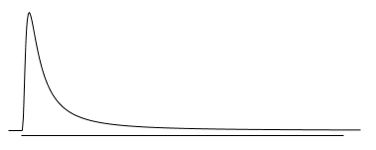
𝑭 distribution and p-value
In order to be able to reject H₀, we need a small p-value, which requires a large F statistic
In order to obtain a large F statistic, variability between sample means needs to be greater than variability within sample means

Slide 26
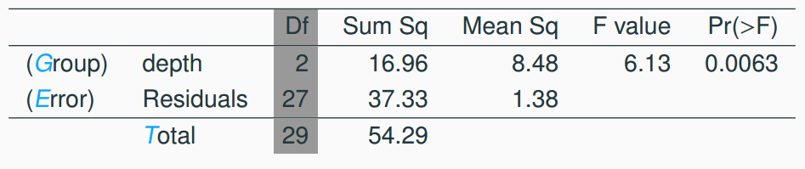
Degrees of freedom associated with ANOVA
groups: df_{G} = k - 1, where k is the number of groups
total: df_{T} = n - 1, where n is the total sample size
error: df_{E} = df_{T} - df_{G}

Slide 27
Degrees of freedom associated with ANOVA
groups: df_{G} = k - 1, where k is the number of groups
total: df_{T} = n - 1, where n is the total sample size
error: df_{E} = df_{T} - df_{G}
df_{G} = k - 1 = 3 - 1 = 2

Slide 28
Degrees of freedom associated with ANOVA
groups: df_{G} = k - 1, where k is the number of groups
total: df_{T} = n - 1, where n is the total sample size
error: df_{E} = df_{T} - df_{G}
df_{G} = k - 1 = 3 - 1 = 2
df_{T} = n - 1 = 30 - 1 = 29

Slide 29
Degrees of freedom associated with ANOVA
groups: df_{G} = k - 1, where k is the number of groups
total: df_{T} = n - 1, where n is the total sample size
error: df_{E} = df_{T} - df_{G}
df_{G} = k - 1 = 3 - 1 = 2
df_{T} = n - 1 = 30 - 1 = 29
df_{E} = 29 - 2 = 27

Slide 30
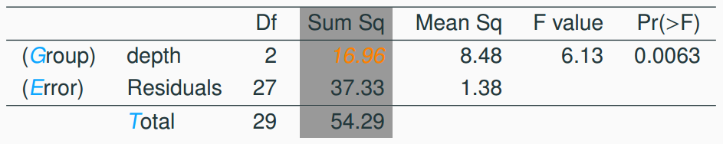



Sum of squares between groups, SSG
Measures the variability between groups
where is each group size, is the average for each group, is the overall (grand) mean

Slide 31
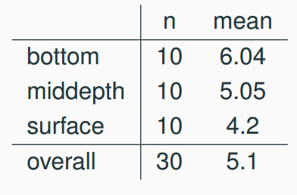
Sum of squares between groups, SSG
Measures the variability between groups
where is each group size, is the average for each group, is the overall (grand) mean

Slide 32

Sum of squares between groups, SSG
Measures the variability between groups
where is each group size, is the average for each group, is the overall (grand) mean

Slide 33

Sum of squares between groups, SSG
Measures the variability between groups
where is each group size, is the average for each group, is the overall (grand) mean

Slide 34

Sum of squares between groups, SSG
Measures the variability between groups
where is each group size, is the average for each group, is the overall (grand) mean

Slide 35
Sum of squares between groups, SSG
Measures the variability between groups
where is each group size, is the average for each group, is the overall (grand) mean

Slide 36

Sum of squares between groups, SSG
Measures the variability between groups
where is each group size, is the average for each group, is the overall (grand) mean

Slide 37
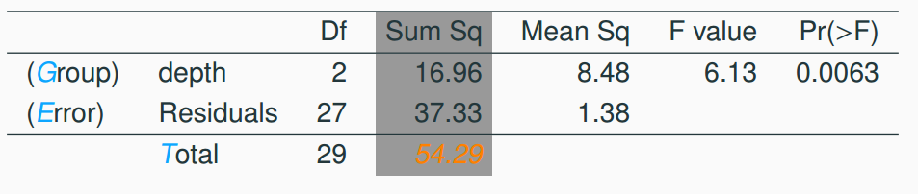
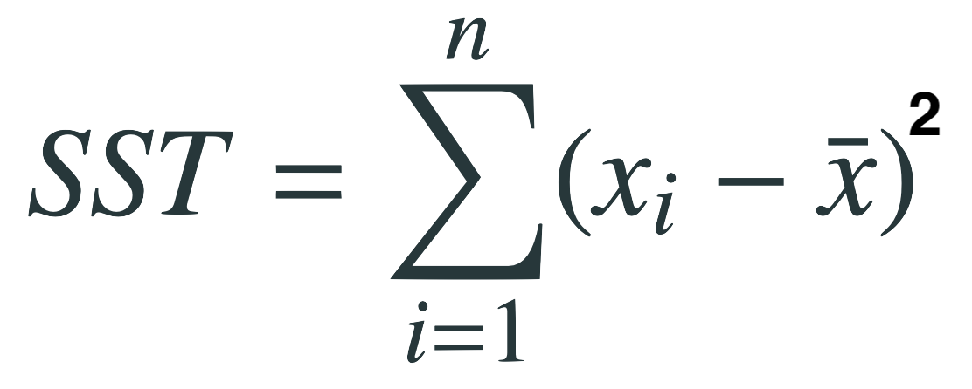
Sum of squares total, SST
Measures the variability between groups
where x_{i} represent each observation in the dataset

Slide 38
Sum of squares total, SST
Measures the variability between groups
where x_{i} represent each observation in the dataset
SST = (3.8 - 5.1)² + (4.8 - 5.1)² + (4.9 - 5.1)² + … + (5.2 - 5.1)²

Slide 39
Sum of squares total, SST
Measures the variability between groups
where x_{i} represent each observation in the dataset
SST = (3.8 - 5.1)² + (4.8 - 5.1)² + (4.9 - 5.1)² + … + (5.2 - 5.1)²
= (-1.3)² + (-0.3)² + (-0.2)² + … + (0.1)²

Slide 40
Sum of squares total, SST
Measures the variability between groups
where x_{i} represent each observation in the dataset
SST = (3.8 - 5.1)² + (4.8 - 5.1)² + (4.9 - 5.1)² + … + (5.2 - 5.1)²
= (-1.3)² + (-0.3)² + (-0.2)² + … + (0.1)²
= 1.69 + 0.09 + 0.04 + … + 0.01

Slide 41
Sum of squares total, SST
Measures the variability between groups
where x_{i} represent each observation in the dataset
SST = (3.8 - 5.1)² + (4.8 - 5.1)² + (4.9 - 5.1)² + … + (5.2 - 5.1)²
= (-1.3)² + (-0.3)² + (-0.2)² + … + (0.1)²
= 1.69 + 0.09 + 0.04 + … + 0.01
= 54.29

Slide 42
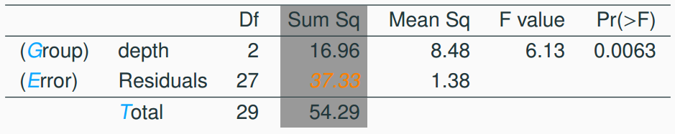
Sum of squares error, SSE
Measures the variability within groups:
SSE = SST - SSG

Slide 43
Sum of squares error, SSE
Measures the variability within groups:
SSE = SST - SSG
SSE = 54.29 - 16.96 = 37.33

Slide 44
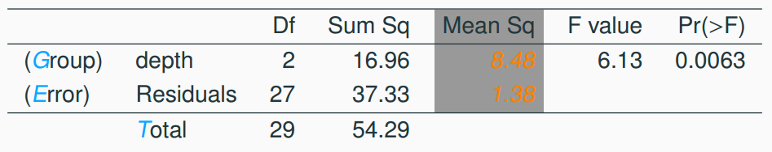
Mean square error
Mean square error is calculated as sum of squares divided by the degrees of freedom

Slide 45
Mean square error
Mean square error is calculated as sum of squares divided by the degrees of freedom
MSG = 16.96/2 = 8.48

Slide 46
Mean square error
Mean square error is calculated as sum of squares divided by the degrees of freedom
MSG = 16.96/2 = 8.48
MSE = 37.33/27 = 1.38

Slide 47
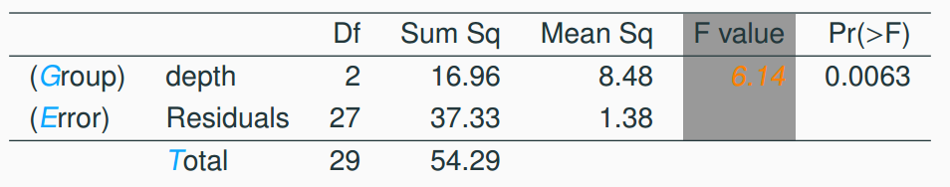

Test statistic, F value
As we discussed before, the F statistic is the ratio of the between group and within group variability

Slide 48

Test statistic, F value
As we discussed before, the F statistic is the ratio of the between group and within group variability

Slide 49
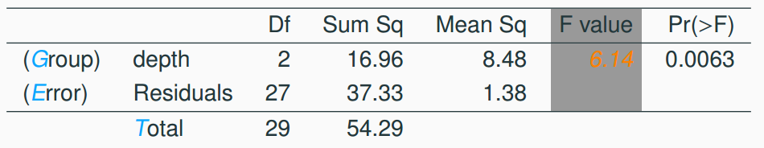
p-value
p-value is the probability of at least as large a ratio between the “between group” and “within group” variability, if in fact the means of all groups are equal. It’s calculated as the area under the F curve, with degrees of freedom df_{G} and df_{E}, above the observed F statistic.

Slide 50
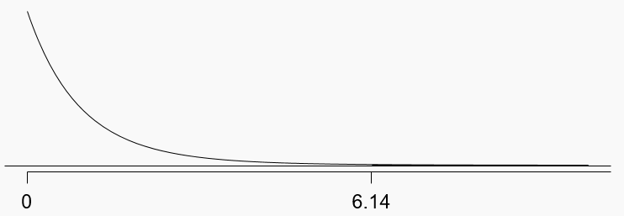
p-value
p-value is the probability of at least as large a ratio between the “between group” and “within group” variability, if in fact the means of all groups are equal. It’s calculated as the area under the F curve, with degrees of freedom df_{G} and df_{E}, above the observed F statistic.
df_{G} = 2; df_{E} = 27

Slide 51
Conclusion - in context
What is the conclusion of the hypothesis test?
The data provide convincing evidence that the average aldrin concentration
is different for all groups
on the surface is lower than the other levels
is different for at least one group
is the same for all groups

Slide 52
Conclusion - in context
What is the conclusion of the hypothesis test?
The data provide convincing evidence that the average aldrin concentration
is different for all groups
on the surface is lower than the other levels
is different for at least one group
is the same for all groups

Slide 53
Conclusion
If p-value is small (less than α), reject H₀. The data provide convincing evidence that at least one mean is different from (but we can’t tell which one)

Slide 54
Conclusion
If p-value is small (less than α), reject H₀. The data provide convincing evidence that at least one mean is different from (but we can’t tell which one)
If p-value is large, fail to reject H₀. The data do not provide convincing evidence that at least one pair of means are different from each other, the observed differences in sample means are attributable to sampling variability (or chance)

Slide 55
independence
Does this condition appear to be satisfied?

Slide 56
independence
Does this condition appear to be satisfied?
In this study the we have no reason to believe that the aldrin concentration won’t be independent of each other

Slide 57
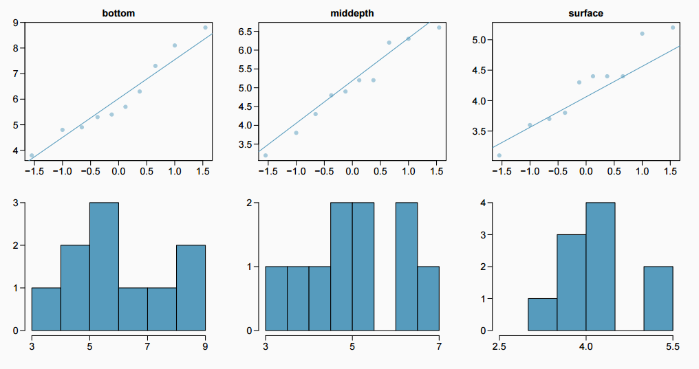
approximately normal
Does this condition appear to be satisfied?

Slide 58
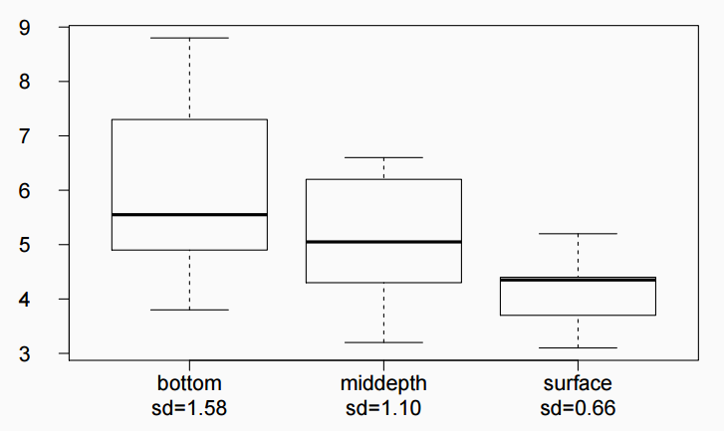
constant variance
Does this condition appear to be satisfied?

Slide 59
Which means differ?
Earlier we concluded that at least one pair of means differ. The natural question that follows is “which ones?”

Slide 60
Which means differ?
Earlier we concluded that at least one pair of means differ. The natural question that follows is “which ones?”
We can do two sample 𝘵 tests for differences in each possible pair of groups

Slide 61
Which means differ?
Earlier we concluded that at least one pair of means differ. The natural question that follows is “which ones?”
We can do two sample 𝘵 tests for differences in each possible pair of groups
Can you see any pitfalls with this approach?

Slide 62
Which means differ?
Earlier we concluded that at least one pair of means differ. The natural question that follows is “which ones?”
We can do two sample 𝘵 tests for differences in each possible pair of groups
Can you see any pitfalls with this approach?
When we run too many tests, the Type 1 Error rate increases
This issue is resolved by using a modified significance level

Slide 63
Multiple comparisons
The scenario of testing many pairs of groups is called multiple comparisons

Slide 64
Multiple comparisons
The scenario of testing many pairs of groups is called multiple comparisons
The Bonferroni correction suggests that a more stringent significance level is more appropriate for these tests:
𝛼* = 𝛼/K
where K is the number of comparisons being considered

Slide 65

Multiple comparisons
The scenario of testing many pairs of groups is called multiple comparisons
The Bonferroni correction suggests that a more stringent significance level is more appropriate for these tests:
𝛼* = 𝛼/K
where K is the number of comparisons being considered
If there are k groups, then usually all possible pairs are compared and

Slide 66
Determining the modified 𝛼
In the aldrin data set depth has 3 levels: bottom, mid-depth, and surface. If α = 0.05, what should be the modified significance level for two sample t tests for determining which pairs of groups have significantly different means?
𝛼* = 0.05
𝛼* = 0.05/2 = 0.025
𝛼* = 0.05/3 = 0.0167
𝛼* = 0.05/6 = 0.0083

Slide 67
Determining the modified 𝛼
In the aldrin data set depth has 3 levels: bottom, mid-depth, and surface. If α = 0.05, what should be the modified significance level for two sample t tests for determining which pairs of groups have significantly different means?
𝛼* = 0.05
𝛼* = 0.05/2 = 0.025
𝛼* = 0.05/3 = 0.0167
𝛼* = 0.05/6 = 0.0083

Slide 68
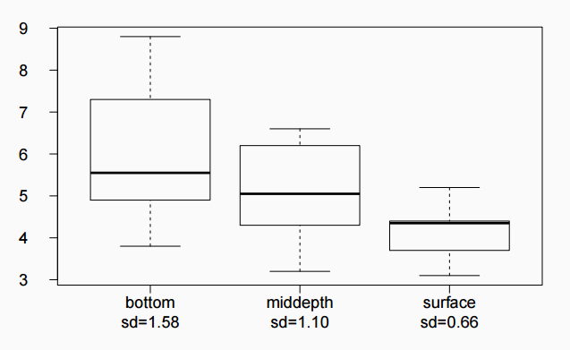
Which means differ?
Based on the box plots below, which means would you expect to be significantly different?
bottom & surface
bottom & mid-depth
mid-depth & surface
bottom & mid-depth;
mid-depth & surface
bottom & mid-depth;
bottom & surface;
mid-depth & surface

Slide 69


Which means differ? (cont.)
If the ANOVA assumption of equal variability across groups is satisfied, we can use the data from all groups to estimate variability:
Estimate any within-group standard deviation with , which is s_{pooled}
Use the error degrees of freedom, n − k, for t-distributions
Difference in two means: after ANOVA

Slide 70
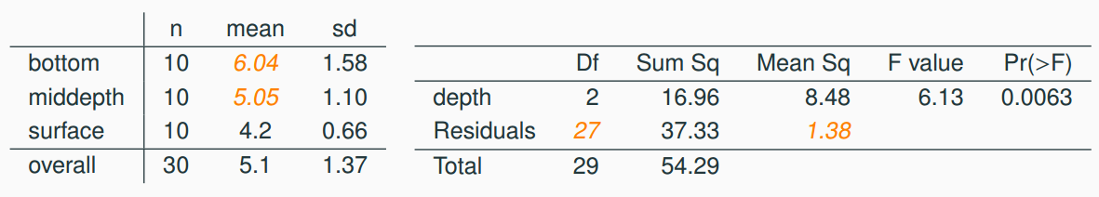
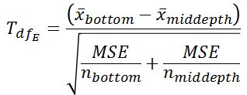
Is there a difference between the average aldrin concentration at the bottom and at mid depth?

Slide 71

Is there a difference between the average aldrin concentration at the bottom and at mid depth?

Slide 72
Is there a difference between the average aldrin concentration at the bottom and at mid depth?

Slide 73

Is there a difference between the average aldrin concentration at the bottom and at mid depth?

Slide 74
Is there a difference between the average aldrin concentration at the bottom and at mid depth?
Fail to reject H₀, the data do not provide convincing evidence of a difference between the average aldrin concentrations at bottom and mid depth

Slide 75
Pairwise comparisons
Is there a difference between the average aldrin concentration at the bottom and at surface?

Slide 76
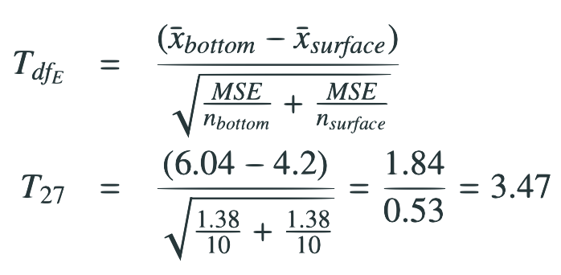
Pairwise comparisons
Is there a difference between the average aldrin concentration at the bottom and at surface?

Slide 77
Pairwise comparisons
Is there a difference between the average aldrin concentration at the bottom and at surface?

Slide 78

Pairwise comparisons
Is there a difference between the average aldrin concentration at the bottom and at surface?

Slide 79
Pairwise comparisons
Is there a difference between the average aldrin concentration at the bottom and at surface?

Slide 80
Pairwise comparisons
Is there a difference between the average aldrin concentration at the bottom and at surface?
Reject H₀, the data provide convincing evidence of a difference between the average aldrin concentrations at bottom and surface

Slide 81
Find more resources at openintro.org/os, including
Slides
Videos
Statistical Software Labs
Discussion Forums (free support for students and teachers)
Learning Objectives
Teachers only content is also available for Verified Teachers, including
Exercise solutions
Sample exams
Ability to request a free desk copy for a course
Statistics Teachers email group
Questions? Contact us.

